Slide 1
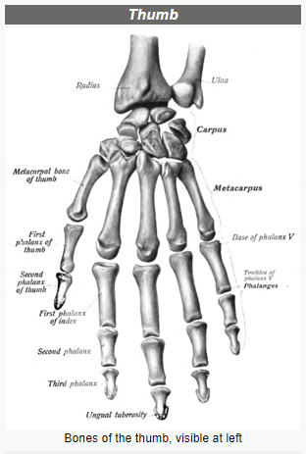
Importance of Thumb
Most primates (humans, apes, and Old World monkeys) and some other animals have opposable thumbs.
Humans can move their thumb farther across their hand than any other primate.
Having opposable thumbs helps in grasping things more easily, picking up small objects, and eating with one hand.
An opposable thumb is a physical adaptation for primates. Opposable thumbs help monkeys and apes climb trees and gather and eat their food. Opposable thumbs help humans operate tools to make use of resources in our environment.

Slide 2
PROBLEM STATEMENT
Some People around the world has lost the ability to lift and move things. This led them hardships in their daily life.
We will try our best to help them rebuild their lost abilities to some extent so that they can at least face less difficulties in their daily life works.

Slide 3
NOVELTY
Some People around the world has lost the ability to lift and move things. This led them hardships in their daily life.
These people also has lost the confidence to be social in their daily basis because of this.
Our custom 3-D printed limbs will be cheap and feasible.
Also as people ages their body parts became weak but our 3-D printed limbs will not become weak.

Slide 4
Execution
Design:
The mechanical structure will be designed
The electrical circuit will be determined.
The design will be confirmed by combining the mechanical and electrical requirements.
Manufacturing:
The mechanical structure will be 3D printed.
The electrical circuits will be made and the motors will be placed in required position.
The sensors will be placed and then the whole system will be tested.

Slide 5
Future Scope:
First we will be using a test subject to collect the data set for the thumb movement for a whole day. This unfiltered data set will contain the data about the movement of the thumb according to the movement of the other fingers.
Then we will be using K-means clustering to cluster out the data which will contain the filtered data about the movement of the thumb according to specific movement of fingers for ex. Gripping a water bottle, making a fist, shaking hand etc. Then we will map out the data using logistics regression which will be helpful in making the prediction model.
To train the dataset further we will be using error back propagation statistical modelling AI method.

